Slide 1
Con Edison Clean Heat
March Webinar
March 19, 2024

Slide 2
Agenda
Contractor Spotlight
Program Achievement & Budget
Clean Heat Program Manual Updates
2024 Clean Heat Promotion Rates
Q2 Residential Allocations
Accessing Decommissioning Training Information
Electrification Load Serving Capacity Maps
Upcoming Webinars & Training
Q&A

Slide 3
Agenda
Contractor Spotlight
Program Achievement & Budget
Clean Heat Program Manual Updates
2024 Clean Heat Promotion Rates
Q2 Residential Allocations
Accessing Decommissioning Training Information
Electrification Load Serving Capacity Maps
Upcoming Webinars & Training
Q&A

Slide 4
Congratulations Clean Heat Contractors of the Year
Residential Program
  Thank you all who attended the Residential Clean Heat Contractor Recognition Breakfast on January 30th and congratulations to all who were recognized
    2023 Residential ASHP contractor of the year:
      Happy Home LLC
    2023 Residential GSHP contractor of the year:
      Dandelion Energy, Inc.
Small and Medium Business (SMB) Program
  Thank you to all who attended the SMB Networking Event on February 15th and congratulations to all who were recognized
    2023 SMB Clean Heat contractor of the year:
      Stratco Property Group

Slide 5
Residential Contractor Spotlight
January Contractor of the Month: Digital Appliances & Heating and Cooling, Inc
  Achieved the highest inspection pass rate in the month of December
Tips for improving your inspection pass rate:
  Follow all requirements in the Program’s Standards and Quality Assurance Checklist) and Decommissioning Checklist
  Make sure your technicians watch the decommissioning training webinar and review the corresponding slides
  Review failed inspection reports with your technicians to ensure the same mistakes aren’t made twice

Slide 6
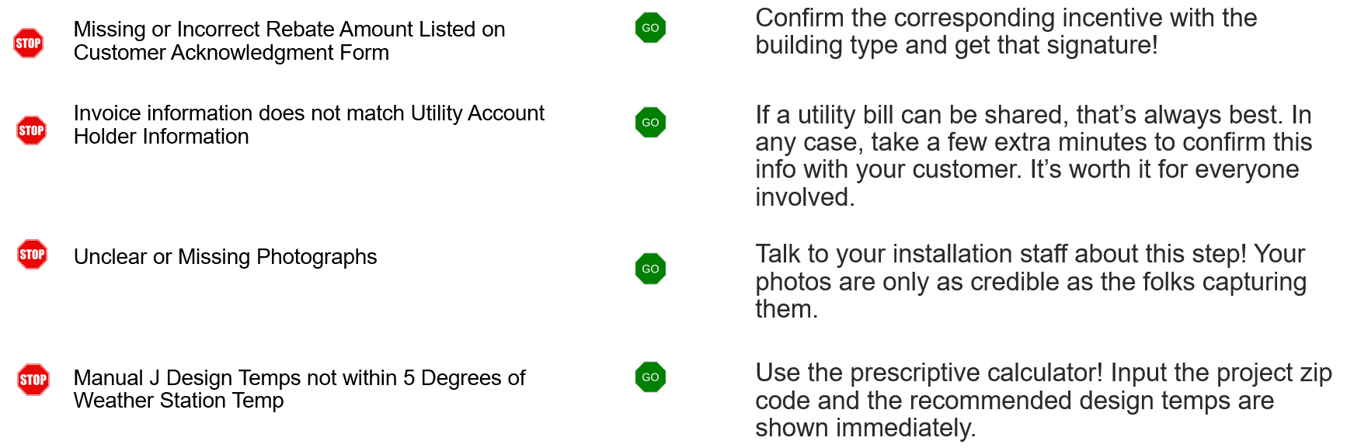
Residential Contractor Spotlight
February Contractor of the Month: BK Appliances Inc.
  Achieved the lowest application flaw rate in the month of January 2024.
Tips for improving your application flaw rate:
  Reach out to your account manager and set up a training
  Review common flaws and how to avoid them

Slide 7
Agenda
Contractor Spotlight
Program Achievement & Budget
Clean Heat Program Manual Updates
2024 Clean Heat Promotion Rates
Q2 Residential Allocations
Accessing Decommissioning Training Information
Electrification Load Serving Capacity Maps
Upcoming Webinars & Training
Q&A

Slide 8
Clean Heat Program Achievement & Budget
Application Intake
Incentives against the Continuity Funding Mechanism by Month
1,057
1,053
$11.6M
$11.0M
9
13
$10.3M
Midstream HPWH
851
$9.3M
823
27
Non-Resi GSHP
42
7
Resi GSHP
8
Non-Resi ASHP
Resi ASHP
November
December
January
February
November
December
January
February

Slide 9
Agenda
Contractor Spotlight
Program Achievement & Budget
Clean Heat Program Manual Updates
2024 Clean Heat Promotion Rates
Q2 Residential Allocations
Accessing Decommissioning Training Information
Electrification Load Serving Capacity Maps
Upcoming Webinars & Training
Q&A

Slide 10
March 1, 2024, Program Manual Updates
Incentives
  Codifies the Limited Time Offers (LTO) introduced in December
    Residential ASHP and GSHP, Small and Medium Business, and Multifamily
  Introduces new incentives and LTOs
    Non-residential GSHP
      LTO and incentives for GSHP Thermal Conductivity Testing (TCT)
    C&I: LTO
New Residential Clean Heat category
  Air-to-water heat pumps (AWHP) (category 2e)
Allows C&I and Multifamily customers to submit applications directly, as they do with other Con Edison Energy Efficiency programs.

Slide 11
Multifamily March 1, 2024, Program Manual Changes
New category - Multifamily prescriptive water (category 6a)
  Targets domestic hot water in multifamily properties for in-unit use with a simple incentive structure
  Incentives of $1,000 per dwelling unit (aka apartment)
  Only full-load air-to-water heat pump installations are eligible for category 6a incentives.
Expanding eligibility for Multifamily offerings
  Expands the eligibility for prescriptive (category 2c) $/dwelling rate up to buildings with 100 units
  Allows buildings of any size to submit for partial load custom categories
Allows Multifamily customers to submit applications directly, as they do with our core Energy Efficiency programs.

Slide 12
Agenda
Contractor Spotlight
Program Achievement & Budget
Clean Heat Program Manual Updates
2024 Clean Heat Promotion Rates
Q2 Residential Allocations
Accessing Decommissioning Training Information
Electrification Load Serving Capacity Maps
Upcoming Webinars & Training
Q&A

Slide 13
2024 Promotion Residential ASHP Decommissioning Rates
To be eligible for the 2024 Promotion, applications must be submitted by May 31st, 2024
Con Edison Clean Heat Residential ASHP Decommissioning Rates (Category 2b)
 | Non-DAC |  | DAC
 | Single family | Apartments | Single family | Apartments
Base Incentive Rates | $8,000 | $4,000 | $10,000 | $5,000
2024 Promotion Rates | $10,000 | $6,000 | $12,000 | $7,000
Project applications submitted after May 31, 2024, will be eligible for the Base Incentive Rates.
Projects in DAC are eligible to receive incentives that cover up to 70% of project costs, while incentives
for projects outside of DACs remain capped at 50% of project costs.

Slide 14
2024 Promotion incentive rates for Residential GSHP
To be eligible for the 2024 Promotion, Residential GSHP projects must:
Be installed by December 31, 2024
Submit signed customer commitments by May 31, 2024
Residential GSHP Decommissioning Rates (Category 3)
 | Non-DAC | DAC
Base Incentive Rates | $25,000 | $35,000
2024 Promotion Rates | $35,000 | $45,000
DAC Guidance
For projects located with a DAC, incentives are capped at 70% of project costs
To determine whether a project is in a DAC search the address at: https://www.nyserda.ny.gov/ny/Disadvantaged-Communities.

Slide 15
2024 Promotion Incentive Rates for non-residential GSHP
To be eligible for 2024 Promotion, Non-Residential GSHP projects must:
Submit applications by May 31, 2024
Installed by September 1, 2025
Pass post-inspection by November 1, 2025
Non-Residential GSHP Rates
 |  | Category 4 Custom Space Heating ($/MMBTU) | Category 4a Custom Space Heating + Envelope ($/MMBTU) Tier 1 Tier 2 |  | Category 6 Hot Water Heating ($/MMBTU)
Base Incentive Rates | New Construction | $125 | $125 | $150 | $125
 | Existing Building | $200 | $200 | $225 | $200
2024 Promotion Rates | New Construction | $150 | $150 | $175 | $150
2024 Promotion Rates | Existing Building | $300 | $300 | $325 | $300

Slide 16
2024 Promotion Incentive Rates for Multifamily
To be eligible for 2024 Promotion, ASHP Multifamily projects must:
Submit applications by May 31, 2024
Installed by the following dates per category:
  Categories 2c and 6: October 1, 2024
  Categories 4, 4a and 10: September 1, 2025
Multifamily ASHP Rates
 | Category 2c Per Apartment ($/Dwelling Unit) | Category 4 Custom Space ($/MMBTU) | Category 4a Custom Space + Envelope ($/MMBTU) Tier 1 Tier 2 |  | Category 6 Custom Water ($/MMBTU) | Category 6a Prescriptive Domestic Hot Water ($/Per Apartment) | Category 10 Custom Partial ($/MMBTU)
Base Incentive Rates | $5,000 | $200 | $200 | $225 | $200 | $1,000 | $70
2024 Promotion Rates | $7,000 | $225 | $225 | $250 | $225 | $1,000 | $95

Slide 17
2024 Promotion incentive rates for C&I
To be eligible for 2024 Promotion, ASHP C&I projects must:
Application Submitted: January 1st, 2024, through May 31st, 2024
Installation Complete By: October 1st, 2024
Post Inspection Passed By: November 1st, 2024
C&I ASHP Rates
 | Category 4 Custom Space ($/MMBTU) | Category 4a Custom Space + Envelope ($/MMBTU) Tier 1 Tier 2 |  | Category 6 Custom Water ($/MMBTU) | Category 10 Custom Partial ($/MMBTU)
Base Incentive Rates | $120 | $120 | $150 | $200 | $70
2024 Promotion Rates | $195 | $195 | $225 | $275 | $145
C&I incentives capped at 50% of project cost or $1M, whichever is lower.
.

Slide 18
2024 Promotion rates for SMB prescriptive projects
To be eligible for the 2024 Promotion, SMB projects must:
Be located within a DAC
Submit applications between December 5, 2023, through May 31, 2024
Be installed by October 1, 2024
SMB Prescriptive Rates (Category 2d) ($/Project)
 | < 1,000 SF | 1,001 – 1,500 SF | 1,501 – 2,000 SF | 2,000 – 2,500 SF
Base Incentive Rates | $5,000 | $7,500 | $10,000 | $12,500
2024 Promotion DAC Rates | $6,000 | $8,500 | $11,000 | $13,500
DAC Guidance
SMB incentives for Category 2d projects located within a DAC will be capped at 60% of project costs.
To determine whether a project is in a DAC search the address at: https://www.nyserda.ny.gov/ny/Disadvantaged-Communities.

Slide 19
SMB: Increased Incentives in 2024 Promotion custom projects
To be eligible for the 2024 Promotion, SMB projects must:
Submit applications by May 31, 2024
Be installed by October 1, 2024
SMB Custom ASHP Rates
 | Category 4 Custom Space ($/MMBTU) | Category 4a Custom Space + Envelope ($/MMBTU)
Base Incentive Rates | $150 | $150
2024 Promotion Rates | $175 | $200
Incentives for customer SMB eligible projects will be capped at $400,000 or 50% of project costs, whichever is lower

Slide 20
Agenda
Contractor Spotlight
Program Achievement & Budget
Clean Heat Program Manual Updates
2024 Clean Heat Promotion Rates
Q2 Residential Allocations
Accessing Decommissioning Training Information
Electrification Load Serving Capacity Maps
Upcoming Webinars & Training
Q&A

Slide 21
Residential Q2 2024 April – June Allocations
GSHP
  Discontinuing allocations process for GSHP Residential Contractors
ASHP
  Contractors received Q2 2024 allocations on Thursday, March 14, 2024
  If necessary, please reach out to your Account Manager for additional funding during Q2

Slide 22
Agenda
Contractor Spotlight
Program Achievement & Budget
Clean Heat Program Manual Updates
2024 Clean Heat Promotion Rates
Q2 Residential Allocations
Accessing Decommissioning Training Information
Electrification Load Serving Capacity Maps
Upcoming Webinars & Training
Q&A

Slide 23
Accessing Decommissioning Training Information
Thank you to all who attended the Decommissioning Training on February 22nd
Access to the training as a resource, the recording, and corresponding slides:
  Decommissioning Training Webinar
If you have any follow-up questions on decommissioning or would like a one-on-one decommissioning training, please reach out to your Account Manager.

Slide 24
Agenda
Contractor Spotlight
Program Achievement & Budget
Clean Heat Program Manual Updates
2024 Clean Heat Promotion Rates
Q2 Residential Allocations
Decommissioning FAQs
Electrification Capacity Map Demonstration
Upcoming Con Edison Webinars & Training
Q&A

Slide 25
Electrification Load Serving Capacity Maps
Con Edison has renamed their Electric Vehicle Charging Capacity map to the Electrification Capacity map to account for the visualization of available hosting capacity for heat electrification, in addition to the visualization of available hosting capacity for potential electric vehicle charging sites.
This map shows transformer capacity data for Con Edison’s underground network electrical system and feeder-level capacity data for Con Edison’s non-network (overhead) system.
25

Slide 26
Methodology
This map displays both transformer and feeder level electrification capacity in both winter and summer.
Summer ratings are appropriate for use in estimating available capacity for electric vehicle charging.
Winter ratings can be used in combination with summer ratings to determine available capacity for building electrification.

Slide 27
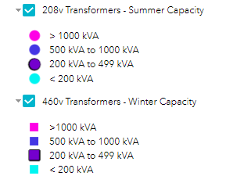
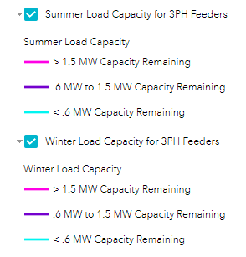

Methodology
Seasonal hosting capacity varies based on equipment ratings, which increase in colder months, and based on seasonal peak load.
Transformers on this map are listed by available capacity and voltage.
Two types of transformers are displayed:
1. 208 volts (shown as circles)
2. 460 volts (shown as squares)
The map shows four levels of transformer capacity, by color.
The map shows three levels of feeder capacity, by color.

Slide 28
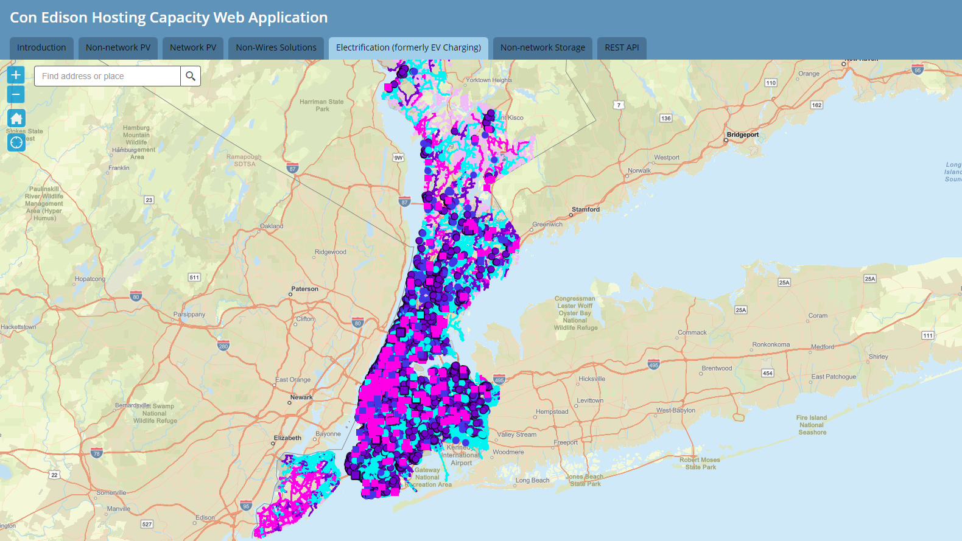


Slide 29
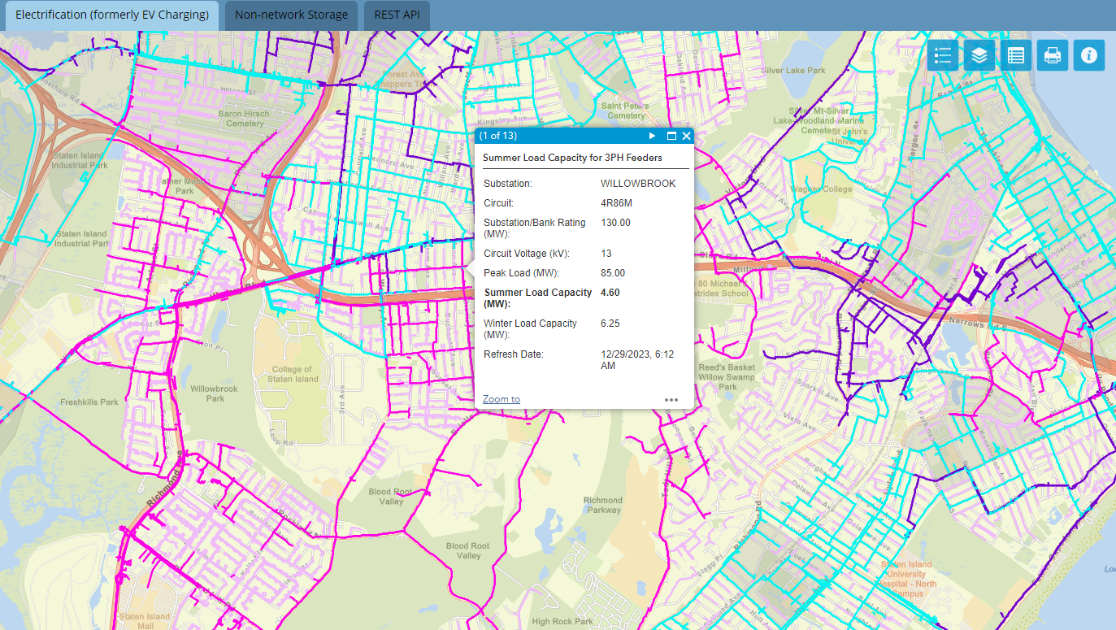

Slide 30
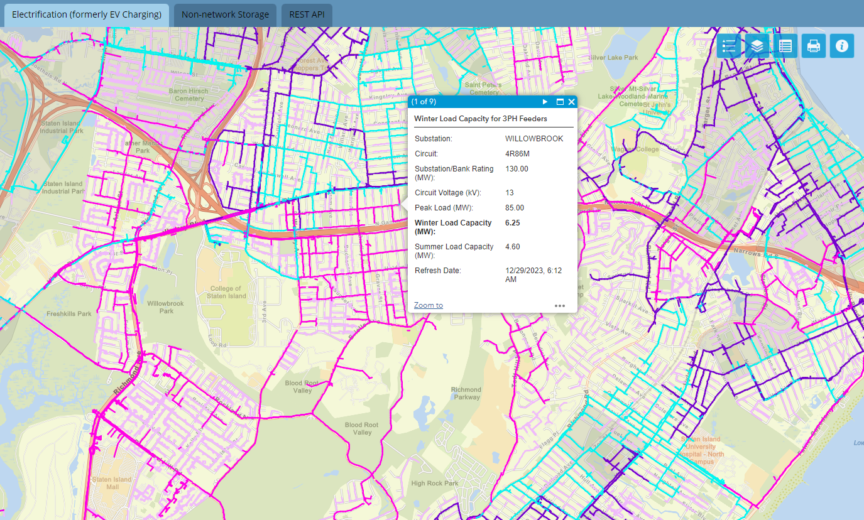

Slide 31
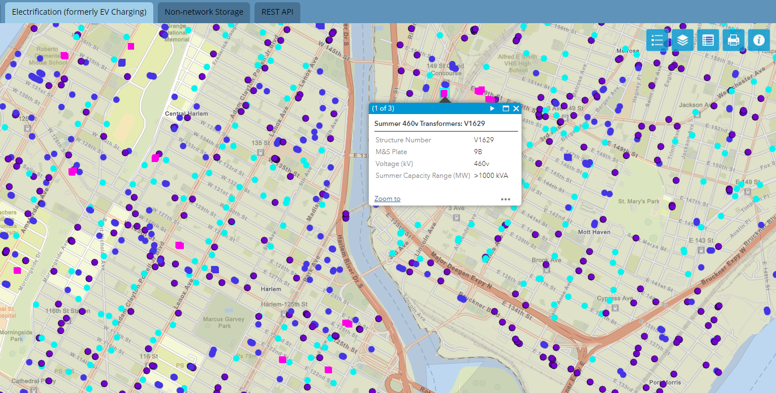

Slide 32
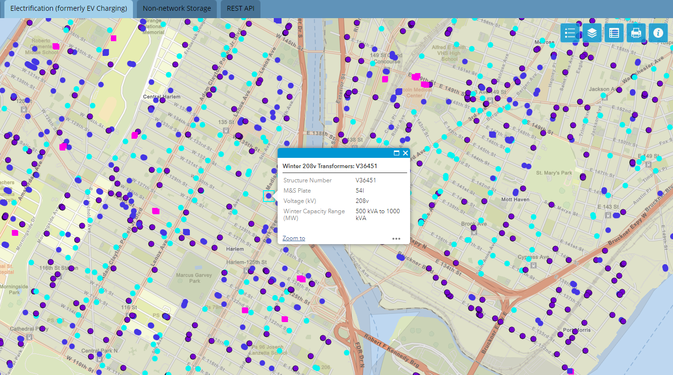

Slide 33
Agenda
Contractor Spotlight
Program Achievement & Budget
Clean Heat Program Manual Updates
2024 Clean Heat Promotion Rates
Q2 Residential Allocations
Accessing Decommissioning Training Information
Electrification Load Serving Capacity Maps
Upcoming Webinars & Training
Q&A

Slide 34
Upcoming webinars and trainings
Participating Contractors and Industry Partners (PC&IP) Working Group Series meeting is scheduled for Thursday, April 18, 2024
  Registration Link
  9:00 – 10:00 a.m.
  For other upcoming trainings, please contact your account manager

Slide 35
Agenda
Contractor Spotlight
Program Achievement & Budget
Clean Heat Program Manual Updates
2024 Clean Heat Promotion Rates
Q2 Residential Allocations
Decommissioning FAQs
Electrification Load Serving Capacity Maps
Upcoming Webinars & Training
Q&A

Slide 36

Q&A
Questions?
Please contact:
Toby Hyde Hydet@coned.com
Dan Krupa Krupad@coned.com
Pablo Colon Colonp@coned.com

